Slide 1
Employee Data Analysis using Excel
STUDENT NAME: Noushin banu.M
REGISTER NO: 122204019
DEPARTMENT: B.Com Corporate Secretaryship
COLLEGE: Shri Krishnaswamy College for Women

Slide 2
PROJECT TITLE
Employee Gender Analysis using Excel

Slide 3


AGENDA
Problem Statement
Project Overview
End Users
Our Solution and Proposition
Dataset Description
Modelling Approach
Results and Discussion
Conclusion
3/21/2024 Annual Review

Slide 4

PROBLEM STATEMENT
Problem: You have a dataset of employee information in Excel, including their names and genders. Your goal is to analyze this data to understand the gender composition of your workforce and identify any potential disparities or imbalances.
Specific Questions:
What is the overall gender ratio within the organization?
Are there significant differences in gender distribution across different departments or job roles?
Are there any trends or patterns in gender representation over time?
Are there any gender-based disparities in terms of salary, promotions, or other workplace factors?
By analyzing this data, you can:
Gain insights into the diversity of your workforce.
Identify areas where there may be opportunities for improvement in terms of gender equality.
Develop strategies to promote a more inclusive and equitable workplace.

Slide 5

PROJECT OVERVIEW
The main goal of this project is to analyze the gender distribution in a dataset of employee information using Excel. This analysis will provide useful insights into the gender makeup of the workforce, identify any potential differences or imbalances, and help develop strategies to promote gender equality.
Data Requirements: -
A dataset with employee information, including:
- Employee ID
-Name
Gender
Department
Job Title
Hire Date
Salary
Performance Ratings

Slide 6
Analysis Methods:
Descriptive Statistics:
Calculate the total number of employees, the percentage of male and female employees, and the overall gender ratio.
- Determine the gender distribution within different departments and job roles.
Data Visualization: -
Create charts (e.g., pie charts, bar charts) to visually represent the gender distribution across various categories.
Use these charts to identify any significant differences or patterns.
Trend Analysis:
Analyze changes in gender distribution over time, particularly focusing on hiring trends and promotions.
Comparative Analysis:
- Compare the gender distribution within the organization to industry benchmarks or relevant standards.

Slide 7
Deliverables:
A comprehensive report summarizing the findings of the analysis, including:
- Overview of the gender distribution within the organization
–Detailed analysis of gender differences across departments, job roles, and over time
Identification of any potential disparities or imbalances
Recommendations for promoting gender equality and addressing identified issues
Visualizations (charts, graphs) to support the analysis and make the findings more accessible.
Expected Outcomes:
A better understanding of the gender composition of the workforce.
Here is the passage broken down into shorter, more concise sentences that use simpler words:
There may be chances to make things better when it comes to gender equality.
Strategies can be made to encourage a more inclusive and fair workplace.
Decisions about HR policies and practices should be based on evidence.
This project will give useful information about the organization's gender diversity.
This will help create a more fair and inclusive work environment.

Slide 8

WHO ARE THE END USERS?
Human Resources (HR) Professionals: They can use the analysis to understand the gender diversity within their organization, identify any biases or disparities, and implement strategies to promote gender equality.
Management: The analysis can help management make informed decisions regarding hiring, promotions, and compensation policies to ensure a fair and equitable workplace.
Diversity and Inclusion (D&I) Committees: These committees can use the data to track progress towards their diversity goals, identify areas for improvement, and advocate for policies that support gender equality.
Researchers and Academics: Researchers studying gender in the workplace can use this data to analyze trends, identify patterns, and contribute to the broader body of knowledge on gender equality.
Government Agencies: Government agencies responsible for labor statistics or equal opportunity may use this type of analysis to track trends in gender representation across industries and inform policy decisions.

Slide 9

OUR SOLUTION AND ITS VALUE PROPOSITION
Our tool is an Excel-based program made to effectively analyze employee gender data. This tool gives a full set of features to help organizations gain valuable insights into their workforce's gender makeup, find potential differences, and develop strategies to promote gender equality.
Key Features:
Data Import and Cleaning: You can easily bring in employee data from different sources and clean it for analysis.
Gender Distribution Analysis: Calculate the overall gender ratio, percentage breakdown, and distribution across different departments and job roles.
Trend Analysis: Analyze changes in gender representation over time, finding hiring trends, promotions, and turnover rates.
- Comparative Analysis: Compare the organization's gender makeup to industry standards or relevant benchmarks
Data Visualization: Create customizable charts (like pie charts and bar charts) to visually show the gender distribution and find trends.
- Reporting: Generate detailed reports summarizing the analysis findings, including suggestions for improvement.

Slide 10
Value Proposition:
1. Gain a deeper understanding of the gender composition of your workforce.
2. Identify potential biases and disparities in your workforce.
3. Make informed decisions about hiring, promotions, and compensation policies based on data.
4. Develop strategies to promote gender equality and create a more inclusive workplace.
5. Ensure compliance with labor laws and regulations related to gender equality.
6. Use a readily available Excel-based tool, avoiding the need for expensive software or consulting services.
Benefits for End Users:
1. HR Professionals can streamline gender analysis, identify areas for improvement, and implement effective diversity and inclusion initiatives.
2. Managers can make informed decisions about talent acquisition, development, and retention strategies.
3. Diversity and Inclusion Committees can track progress towards diversity goals, identify areas for improvement, and advocate for equitable policies.
4. Researchers and Academics can access a user-friendly tool for analyzing gender data and contributing to research on workplace equality.

Slide 11
Dataset Description
Employee ID is a unique number that identifies each employee.
Name is the full name of the employee.
3. Gender is the employee's gender, such as Male, Female, or Non-binary.
4. Department is the division or department where the employee works.
5. Job Title is the specific job or position the employee holds.
6. Hire Date is the date when the employee was hired.
7. Salary is the annual pay of the employee.
8. Performance Rating is a numerical or categorical rating that indicates the employee's work performance.
9. Exit Date (Optional) is the date when the employee left the organization, if applicable.
The data should be organized in a table format, with each row representing an employee and each column representing a specific field. The data should be consistent and free of errors. Numeric fields, such as Salary and Performance Rating, should be formatted as numbers. Date fields, such as Hire Date and Exit Date, should be formatted as dates.

Slide 12
Additional Considerations:
1. Ensure your organization follows data privacy laws and protects sensitive employee information.
2. Verify the data is accurate and complete before analyzing it.
3. If the data comes from different sources, make sure the formats and definitions are consistent. 4. By having a well-organized and complete dataset, you can effectively analyze the distribution of employee gender, find any potential differences, and create strategies to promote gender equality in your organization.

Slide 13

THE "WOW" IN OUR SOLUTION
Our solution stands out by offering a unique combination of features and benefits that provide a truly exceptional experience:
User-Friendly Interface:
- Our tool has an intuitive design that is easy to navigate, even for those without extensive Excel experience.
- The tool provides step-by-step guidance, making it simple for users to conduct their analysis effectively.
2. Comprehensive Analysis:
- Our solution offers a comprehensive set of analysis features, allowing users to explore gender distribution across various dimensions, identify trends, and uncover hidden patterns.
- Users can customize the analysis to suit their specific needs and research questions.
3/21/2024 Annual Review
13

Slide 14
3. Data Visualization Excellence:
- Our tool generates interactive charts that allow users to explore the data visually and gain insights quickly.
- Users can customize the appearance and style of charts to match their preferences and branding.
4. Integration with Existing Systems:
Our solution can be easily connected with current HR systems. This allows for easy sharing of data and analysis.
5. Continuous Improvement:
We will keep improving our tool based on what users say and what is happening in the industry. This ensures the tool remains valuable for organizations.
Our solution has features that make it stand out from other gender analysis tools. It helps organizations make decisions based on data, promote gender equality, and create a more inclusive workplace.

Slide 15
MODELLING
Make sure you understand the structure and content of the dataset before modeling. The key fields are usually:
Employee ID
- Name
Gender
Department
Job Title
Hire Date
Salary
Performance Rating
Modeling Techniques:
Descriptive Statistics:
- Create frequency tables to summarize the gender distribution in the dataset.
Calculate the percentage of each gender (male, female, other).
Analyze the central tendency (mean, median, mode) of numerical variables (like salary) by gender.
15

Slide 16
Cross -Tabulation:
Analyze the relationship between gender and other categories (like department, job title) using cross-tabulation tables.
Perform chi-square tests to see if there are significant gender differences across these categories.
Data Visualization:
- Use bar charts to visualize the gender distribution.
- Use pie charts to show the proportion of each gender.
Use histograms to analyze the distribution of numerical variables (like salary) by gender.
Time Series Analysis (if applicable):
If the data includes historical information, analyze gender representation trends over time using time series techniques.
Create line charts or time series plots to visualize these trends.
Advanced Techniques (if needed):
Use regression analysis to study the relationship between gender and numerical variables (like salary).
Use discriminant analysis to identify factors that distinguish between genders based on multiple variables.
- If the data includes employee turnover, use survival analysis to analyze the time to event (like leaving the company). Here is the passage broken down into shorter, more concise sentences that use simpler words, with considerations by gender:

Slide 17
Data Quality:
Ensure the data is accurate and complete before modeling.
This is important for all genders.
Missing Values:
Handle missing data appropriately, using techniques like imputation or deletion.
This is important for all genders.
Outliers:
Identify and address any extreme data points that may affect the analysis.
This is important for all genders.
Ethical Considerations:
Handle sensitive data ethically and ensure privacy compliance.
This is important for all genders.
Insights:
By applying these modeling techniques, you can gain valuable insights into the gender distribution within your organization.
- This can help identify potential disparities between genders.
- The insights can inform strategies for promoting gender equality.

Slide 18
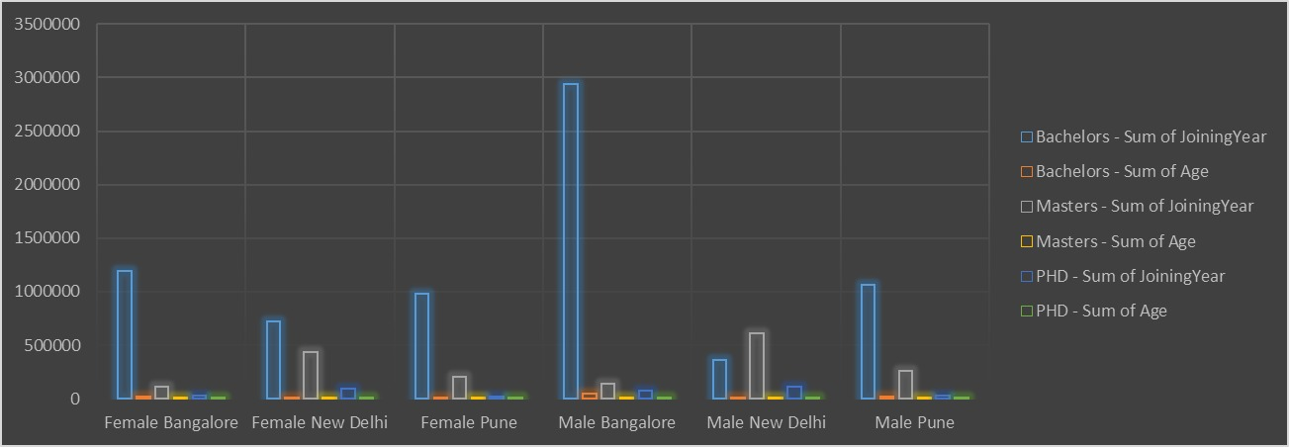
RESULTS
18

Slide 19
Conclusion
It plays a vital role in promoting diversity, inclusion, and equality within the workplace. By collecting and analyzing gender data, organizations can implement targeted initiatives, address disparities, and create a more supportive environment for all employees.
It's all about building a workplace where everyone feels valued, respected, and empowered to succeed.

